Slide 1
On-Ramp to the Office 365 API & Azure AD Highway!

Slide 2






Andrew Connell
www.AndrewConnell.com
me@AndrewConnell.com
@andrewconnell
Full stack web developer & instructor
Co-host, Microsoft Cloud Show – www.MicrosoftCloudShow.com
Hands-On SharePoint Training Critical Path Training - www.CriticalPathTraining.com
On-Demand SharePoint Training Pluralsight – www.Pluralsight.com

Slide 3
Topics
OAuth2 & OpenID Connect Concepts
Azure Active Directory
Office 365 APIs

Slide 4
OAuth & Authentication Concepts

Slide 5
What is OAuth2
Authentication protocol
Once user is authenticated, they obtain access tokens
Digitally signed string containing claims
Access tokens are the “keys” to secured resources
Secured resources trust the issuer of tokens

Slide 6
Terminology
Access token
Refresh token
OAuth flows
Resource
Issuer
User / application

Slide 7
It all Comes Down to Access Tokens
For the app developer, the goal is to obtain an access token
Valid for a specific period of time
Sometimes acquisition of an access token includes an refresh token
Refresh tokens can be used to update access tokens
This token is passed with each HTTP request to authenticate the user and / or the app
Included in the HTTP request header:
Authorization: Bearer [token]

Slide 8
Obtain Access Tokens with OAuth Flows
Obtain access tokens using different defined “OAuth Flows”
Multiple flows defined in OAuth 2.0 spec
Both the Issuer & Resource must support the flow to use it
Flow Options with Office 365 & Azure AD
Authorization Code Flow
Client Credentials Flow (App only)
Implicit Flow

Slide 9
Flow #1 – Authorization Code
Most common
Very secure - application never gets user’s creds
Flow
Web app redirects user to Azure AD to login
Upon successful login, Azure AD redirects user back to web app with an authorization code
Web app uses this code to request access token on behalf of user
Scenarios
Web applications that use federated logins
User interaction present

Slide 10
Flow #2 – Client Credentials
Very powerful
Requires global tenant admin consent
Not user consent
Flow
App configured with the public part of a certificate
App submits an encrypted request to the issuer requesting access token
Issuer returns access token back to requestor
Scenarios
App only rights
Zero user interaction
Service / daemon processes

Slide 11
Flow #3 – Implicit Flow
Must be deliberately set…
Apps don’t support it by default
Enables OAuth2 authentication for apps that are 100% client-side
Scenarios
Client-side application

Slide 12
OpenID Connect – What is It?
OAuth 2.0 is simply an authentication protocol that returns access tokens
No information about the user is included in the response
For instance no details like “who just logged in”
If you want identity details, you have to roll your own solution
OpenID Connect adds identity to OAuth 2.0 process
Very lightweight wrapper … unlike ws-fed
Id token returned by Azure AD with basic claims about the user
http://openid.net/specs/openid-connect-core-1.0.html

Slide 13
Azure Active Directory

Slide 14
Office 365 & Azure AD Directory
Office 365 has a dependency on Azure AD
Every Office 365 tenant has it’s own Azure AD directory
Users in Office 365 tenants are stored in Azure AD directories
Azure AD stores users for Office 365
Also application configurations
Office 365 trusts Azure AD
Azure AD applications can be granted permissions to SharePoint Online & Exchange Online data within Office 365

Slide 15
Azure AD & Azure AD Applications
Enables support for validating users & applications
Users = username & password
Application = client id & key
Supports OAuth 2.0 & OpenID Connect
OAuth 2.0 - base protocol for authentication
OpenID Connect – thin layer around OAuth 2.0 that adds user identity
Upon successful authentication, user / application obtains an OAuth 2.0 access token
Included in every request within HTTP header
Like cash… anyone can use it

Slide 16
Properties of Azure AD Applications
Name
Sign-On URL
Logo
Single or Multi-Tenant
Client ID
Keys
App ID URI
Reply URL
Permissions

Slide 17
Creating Azure AD Applications
Visual Studio 2013
Office Developer Tools for Visual Studio 2013
Connected Service wizard
Visual Studio 2015
Updated Office Developer tools & Connected Service wizard
Azure Management Portal web interface

Slide 18
Demo – Creating AzureAD Apps

Slide 19
Single vs. Multi-Tenant Applications
Single Tenant Apps
Available to all users in your Azure AD directory
Not available to users outside your Azure AD directory
Typically internal apps for your organization’s users
Multi-Tenant Apps
Just like single tenant apps except…
Available to all users in any Azure AD directory
Typically built by ISVs or as a SaaS offering

Slide 20
OAuth2 & AzureAD Authentication Flows

Slide 21
Authentication Flow Overview
Application
Azure AD Authorization Endpoint
Azure AD Token Endpoint
Office 365 API
Request authorization code
Sign-in via browser
Return authorization code
Redeem authorization code and acquire access token for Office 365 resource
Return access token and refresh token
Call Office 365 API using the access token
Return http Response

Slide 22
Azure AD OAuth Authorization Endpoint
https://login.microsoftonline.com/<ad-tenant-id> /oauth2/authorize
https://login.microsoftonline.com/common /oauth2/authorize
?client_id=c5a5591c-bb7d-4b7c-944a-aaa17fa068aa
&redirect_uri=https://www.foo.com/auth
&response_type=code

Slide 23
Azure AD OAuth Token Endpoint (Access)
https://login.microsoftonline.com/<tenant-id> /oauth2/token
https://login.microsoftonline.com/common /oauth2/token
?client_id=c5a5591c-bb7d-4b7c-944a-aaa17fa068aa
&redirect_uri=https://www.foo.com/auth
&client_secret=z19jGC3TmArM4aDg1C1GSVBsfoD5y5…
&grant_type=authorization_code
&code=AAABAAAAvPM1KaPlrEqdFSBzjqfTGBzE2fzOMjs…
&resource=https://graph.windows.net

Slide 24
Azure AD OAuth Token Endpoint (Refresh)
https://login.microsoftonline.com/<tenant-id> /oauth2/token
https://login.microsoftonline.com/common /oauth2/token
?client_id=c5a5591c-bb7d-4b7c-944a-aaa17fa068aa
&redirect_uri=https://www.foo.com/auth
&client_secret=z19jGC3TmArM4aDg1C1GSVBsfoD5y5…
&grant_type=refresh_token
&code=AAABAAAAvPM1KaPlrEqdFSBzjqfTGPi91jyYrww…
&resource=https://outlook.office365.com

Slide 25
DEMO - Inspecting the Authentication Process Flow

Slide 26
OpenID Connect

Slide 27
OpenID Connect
https://login.microsoftonline.com/<tenant-id> /oauth2/authorize
https://login.microsoftonline.com/common /oauth2/authorize
?client_id=c5a5591c-bb7d-4b7c-944a-aaa17fa068aa
&redirect_uri=https://www.foo.com/auth
&response_type=code+id_token

Slide 28
OpenID Connect’s ID Token
{
aud: "c0d204d8-1f5b-424e-944c-489cab675586",
iss: "https://sts.windows.net/4254573b-5de2-452e-b706-30eed7ce1ebf/",
nbf: 1421785651, exp: 1421789551,
upn: "andrew.connell@acio36503.onmicrosoft.com",
sub: "1rxMpLjHWTQxMrsQDw8KtkwxICCftlL1UX29CFbfOTM",
given_name: "Andrew", family_name: "Connell",
name: "Andrew Connell",
unique_name: "andrew.connell@acio36503.onmicrosoft.com",
pwd_exp: "7433009",
pwd_url: https://portal.microsoftonline.com/ChangePassword.aspx
}

Slide 29
App-Only Permissions

Slide 30
Application & Delegated Permissions
Delegated Permissions | User + App
Apps & users have permissions
Act on behalf of a user
User (or tenant admin) grants app rights to app on it’s behalf
App is thus delegated permissions by the user
App & user must both have permissions
Application Permissions | App-Only
Apps have permissions
Acts independent of user
Tenant admin grants app rights to all users within the organization
Users do not need to grant app permissions
App then acts independently of the users in the organization

Slide 31
App-Only Characteristics
Apps that utilize the app-only permission model have different configuration & usage requirements than those that leverage app+user permissions
App+User permission model:
Apps identified by client ID & keys
Users grant app permissions & obtain access tokens after they authenticate
Use refresh tokens to acquire new access token without re-authenticating
App-Only permission model:
Apps identified by client ID & certificate
Tenant admin grants app permission to all users in the organization
App obtains access tokens; refresh tokens not used

Slide 32
App-Only Authentication Flow Overview
Application
Azure AD Authorization Endpoint
Azure AD Token Endpoint
Office 365 API
Request authorization code
Sign-in via browser
Return OpenID Connect ID token
Submit signed token and acquire access token for Office 365 resource
Return access token
Call Office 365 API using the access token
Return http Response

Slide 33
App-Only – Authorization Endpoint Request
https://login.microsoftonline.com/common
/oauth2/authorize
?state=001adebf-3565-4745-b07f-d421f6ba84c2
&response_type=code+id_token
&scope=openid
&nonce=e9615b42-3aff-44e4-a6cd-7bd7904f920a
&client_id=65923aa3-ec8b-4f6c-acbb-ed2f90ecf59d
&redirect_uri=https://www.foo.com/auth
&resource=https://graph.windows.net/
&prompt=admin_consent
&response_mode=form_post

Slide 34
App-Only – Token Endpoint Request
https://login.microsoftonline.com/<tenant-id>
/oauth2/token
resource=https://graph.windows.net/
&client_id=65923aa3-ec8b-4f6c-acbb-ed2f90ecf59d
&client_assertion_type= urn:ietf:params:oauth:client-assertion-type:jwt-bearer
&client_assertion=<signed jwt token>
&grant_type=client_credentials

Slide 35
DEMO – App Only Permissions

Slide 36
Office 365 APIs

Slide 37
Office 365 APIs
First released as version 1.0 late 2014
Sites API (SharePoint)
Contacts API
Calendar API
Mail API
Files API (OneDrive for Business)
Discovery Service
All Office 365 APIs share some common characteristics
Azure Active Directory apps
Authentication & authorization
Versioning
SDK & OData / REST
Tooling

Slide 38
Upon the v1.0 Release to Today….
Each API had it’s own endpoint
Each API had it’s own resource ID
Needed separate access token for each endpoint

Slide 39
Challenges Without the Discovery Service
Critical parts of all Office 365 APIs:
Service resource ID
Service endpoint URL
Some resource IDs & service endpoint URLs are predictable
Contacts, calendar, mail…
Some are not predictable…
Files (aka: OneDrive for Business)

Slide 40
How Does the Discovery Service Help?
Returns a list of all Office 365 API services the user has access to
Services the user does not have access to are omitted
Omitted services – those the Azure AD application does not have rights to
Includes the necessary information to connect to the services
Service resource ID
Service endpoint URL
Discovery service well-known details:
Service resource ID = https://api.office.com/discovery
Service endpoint URL = https://api.office.com/discovery/v1.0/me

Slide 41
DEMO – Discovery Service

Slide 42
Exchange Online Related APIs
Contacts API
Calendar API
Mail API

Slide 43
Check the Office Dev Training Content
Most of the following samples are pulled from Office Dev’s training content
Hands on labs
Links to videos
Completed lab samples
dev.office.com/training
github.com/OfficeDev/TrainingContent

Slide 44
DEMO – Exchange Online APIs

Slide 45
Sites API & Files API
Sites API
Exposes parts of the SharePoint Online REST API
Data within lists
Files API
Data within libraries
OneDrive for Business

Slide 46
DEMO – Sites API & Files API

Slide 47
Additional Office 365 API Endpoints
Video Portal
Groups
Skype

Slide 48
Unified API

Slide 49
Office 365 Unified API
Single API “proxy” to all underlying apps
Will remove the need for the Discovery Service
Currently in preview
Breakout Session “Office 365 Unified API (preview)”
Video from Build - channel9.msdn.com/Events/Build/2015/3-641
Session @ Ignite: BRK3199, Tuesday @ 10:45 by Yina Arenas

Slide 50

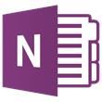






Data silos in the enterprise
USER
FILES
EMAIL AND CONVERSATIONS
EVENTS
PEOPLE
GROUPS

Slide 51
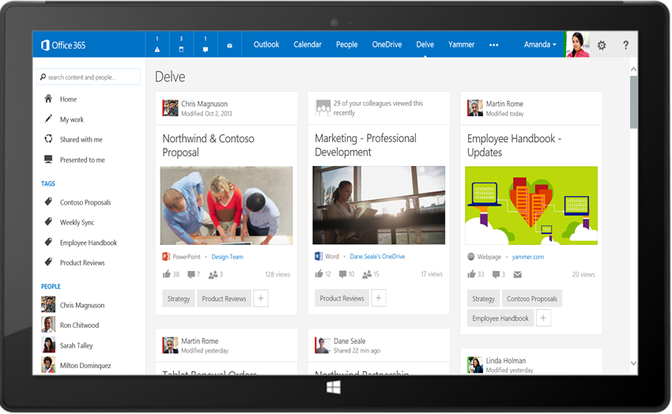
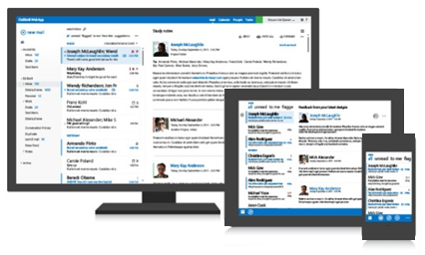
Office 365 unified API
Your App
https://graph.microsoft.com/
USERS
GROUPS
FILES
MAIL
CALENDAR
TASKS
Insights and relationships from Office Graph

Slide 52
/me
USER
ME
userPhoto
thumbnailPhoto
responsibilities
pastProjects
hireDate
address
mobile
jobTitle
schools
name
skills
alias
department
aboutMe
birthday
tags

Slide 53
/users
manager
USER
directReports
memberOf
GROUPS

Slide 54
/messages
manager
USER
directReports
memberOf
GROUPS
MESSAGES

Slide 55
/events
manager
USER
directReports
EVENTS
memberOf
GROUPS
MESSAGES
MESSAGES

Slide 56
/files
Shared with me
createdBy
public
manager
USER
directReports
directReports
EVENTS
EVENTS
modifiedBy
FILES
memberOf
GROUPS
MESSAGES

Slide 57
/groups
Shared with me
Shared with me
createdBy
createdBy
CONVERSATIONS
public
public
manager
USER
directReports
directReports
directReports
directReports
EVENTS
EVENTS
modifiedBy
modifiedBy
FILES
FILES
memberOf
memberOf
GROUPS
GROUPS
createdBy
MESSAGES
FILES

Slide 58
/workingWith
Shared with me
createdBy
CONVERSATIONS
CONVERSATIONS
public
manager
USER
workingWith
directReports
directReports
EVENTS
EVENTS
EVENTS
modifiedBy
FILES
memberOf
memberOf
memberOf
workingWith
GROUPS
GROUPS
GROUPS
createdBy
createdBy
MESSAGES
FILES
FILES

Slide 59
/trendingAround
trendingAround
Shared with me
createdBy
CONVERSATIONS
public
workingWith
manager
USER
workingWith
directReports
directReports
directReports
EVENTS
EVENTS
trendingAround
modifiedBy
FILES
memberOf
memberOf
workingWith
workingWith
GROUPS
GROUPS
createdBy
MESSAGES
FILES

Slide 60
API
trendingAround
Shared with me
createdBy
CONVERSATIONS
public
manager
USER
workingWith
directReports
EVENTS
trendingAround
modifiedBy
TASKS
FILES
memberOf
workingWith
TASKS
GROUPS
createdBy
NOTES
NOTES
MESSAGES
FILES

Slide 61
DEMO – Unified API

Slide 62
Additional APIs Recently Announced
Office Graph API
Interact with the API that powers Delve
Video Portal API
View & upload videos to channels
View contents of channels
Groups API
OneNote API

Slide 63
Summary
Enterprise JavaScript
Enterprise Services Architecture
Enterprise Frameworks
OAuth2 Primer
Azure Active Directory
Office 365 APIs

Slide 64

Thanks! Questions?
github.com/andrewconnell/pres-o365api-aad-workshop

